Slide 1
Direct Market Access for Farmers Application Development using machine learning
PIP2001 Capstone Project
Review-0
Batch Number: ISR-06
Under the Supervision of,
Dr. SIVARAMAKRISHNAN
School of Computer Science and Engineering
Presidency University
Roll Number | Student Name
20211ISR0057 | AKSHAY B
20211ISR0060 | KARTHIK M SWAMY
20211ISR0076 | JERA PRAKASH
Name of the Program: B.Tech
Name of the HoD: Dr. ZAFAR ALI KHAN
Name of the Program Project Coordinator: Dr. Afroz pasha
Name of the School Project Coordinators: Dr. Sampath A K / Dr. Abdul Khadar A / Mr. Md Ziaur Rahman

Slide 2
Content
Problem Statement
Github Link
Analysis of Problem Statement
Timeline of the Project
References

Slide 3
Problem Statement Number: PSCS_342
Organization: Ministry of Agriculture and Farmers Welfare
Category (Hardware / Software / Both) : Software
Problem Description: Background: Farmers often face challenges in accessing markets, leading to lower income due to middlemen. This gap restricts their ability to sell produce at fair prices. Description: Create a mobile application that connects farmers directly with consumers and retailers. The app should include features for listing produce, negotiating prices, and managing transactions, thereby reducing dependence on intermediaries. Expected Solution: A user-friendly mobile platform that enables farmers to showcase their products and connect with buyers directly, enhancing their income potential.
Difficulty Level: Complex

Slide 4
Github Link
https://github.com/jprakash2003/Mobile-app-for-direct-market-access-for-farmers-

Slide 5
Analysis of Problem Statement (contd...)
Software and Hardware Requirements:
Android studio application: Android Studio is an integrated development environment (IDE) for building Android applications. It provides powerful tools for coding, debugging, and testing, as well as a rich user interface designer.

Slide 6
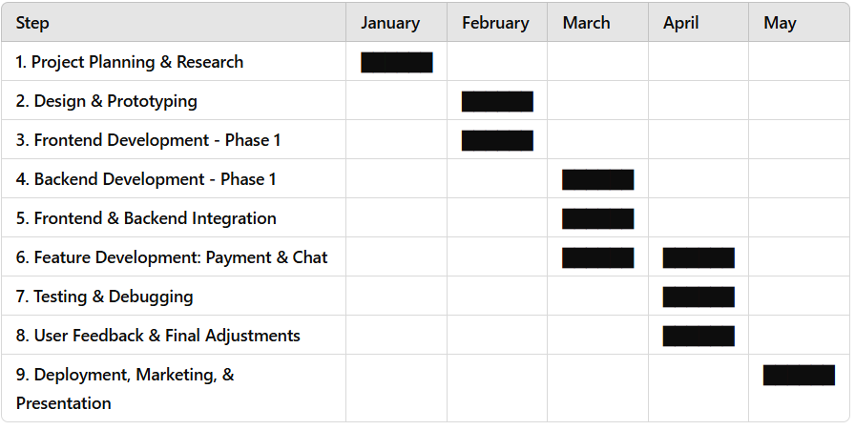
Timeline of the Project (Gantt Chart)

Slide 7
References (IEEE Paper format)
Add APA Citation for all references.
Use the below link for various APA styles :
https://www.indeed.com/career-advice/career-development/how-to-cite-a-research-paper

Slide 8


